Slide 1

Enterprise Software Development
Notes:
TODO: add on slide title 1.2

Slide 2

Angular 2 Template Syntax
Angular Super Powers Tour
Notes:
I wish I had been given this talk

Slide 3

Duncan Hunter
@DuncHunter
Software Architect
Focus on Angular and TypeScript
Rock climber
Notes:
Spend the most of my time building ng and ts
This is actually me in Jervis Bay south of Sydney
Follow me on twitter

Slide 4

Agenda
1. Why the new syntax?
2. Property Binding & Event Binding
3. Attribute, Class and Style Bindings
4. Built-in Directives
5. Input and Output Properties
Notes:
Approx. 45min for the 10 qu and the Q&A

Slide 5
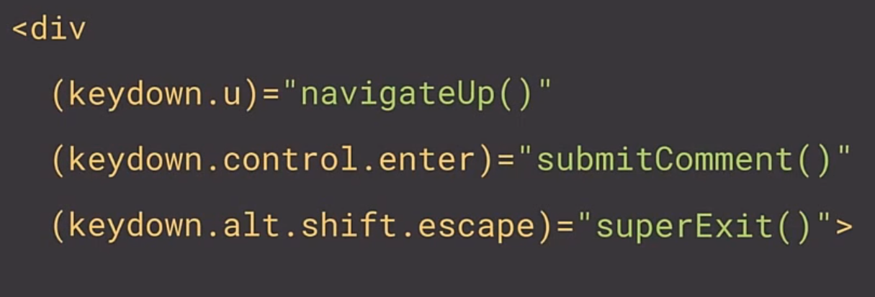
Why Angular2 will be rad!

Slide 6
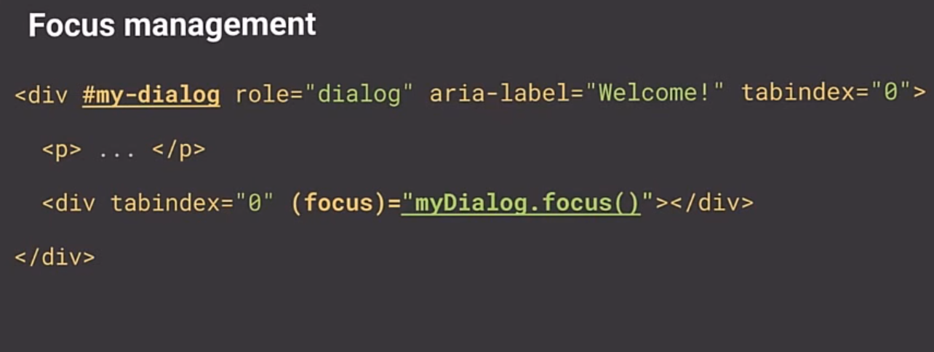
Why Angular2 will be rad!

Slide 7
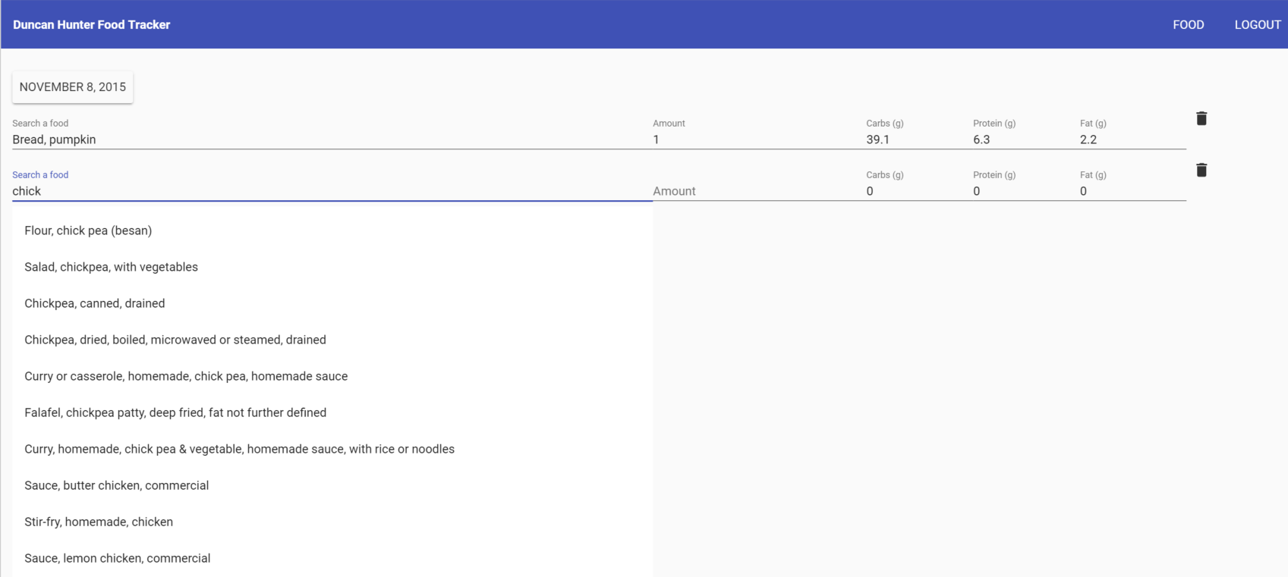

Why Angular2 will be rad!

Slide 8
Is this valid syntax?
Yes
No
Attribute names must consist of one or more characters other than the space characters, U+0000 NULL, """, "'", ">", "/", "=", the control characters, and any characters that are not defined by Unicode.

Slide 9
Is this valid syntax?
Yes
No
Attribute names must consist of one or more characters other than the space characters, U+0000 NULL, """, "'", ">", "/", "=", the control characters, and any characters that are not defined by Unicode.

Slide 10
Main template syntax to learn
{{ }} = Interpolation
[ ] = Property Binding
( ) = Event Binding
* = Template
# = Reference

Slide 11
A lot less angular directives
<button ng-click=“vm.onClick()”></button>
<button (click)=“onClick”></button>
This means native DOM events!

Slide 12
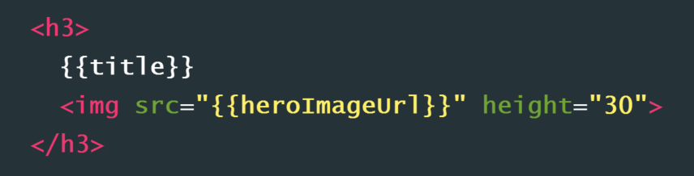
Interpolation

Slide 13
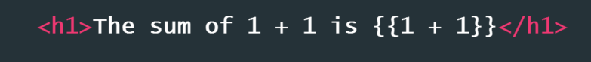
Interpolation

Slide 14
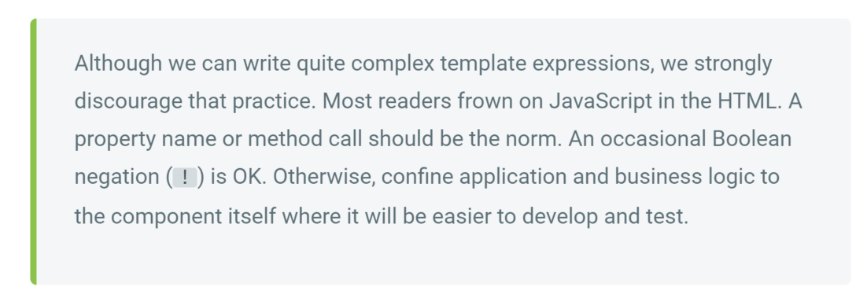
Interpolation

Slide 15
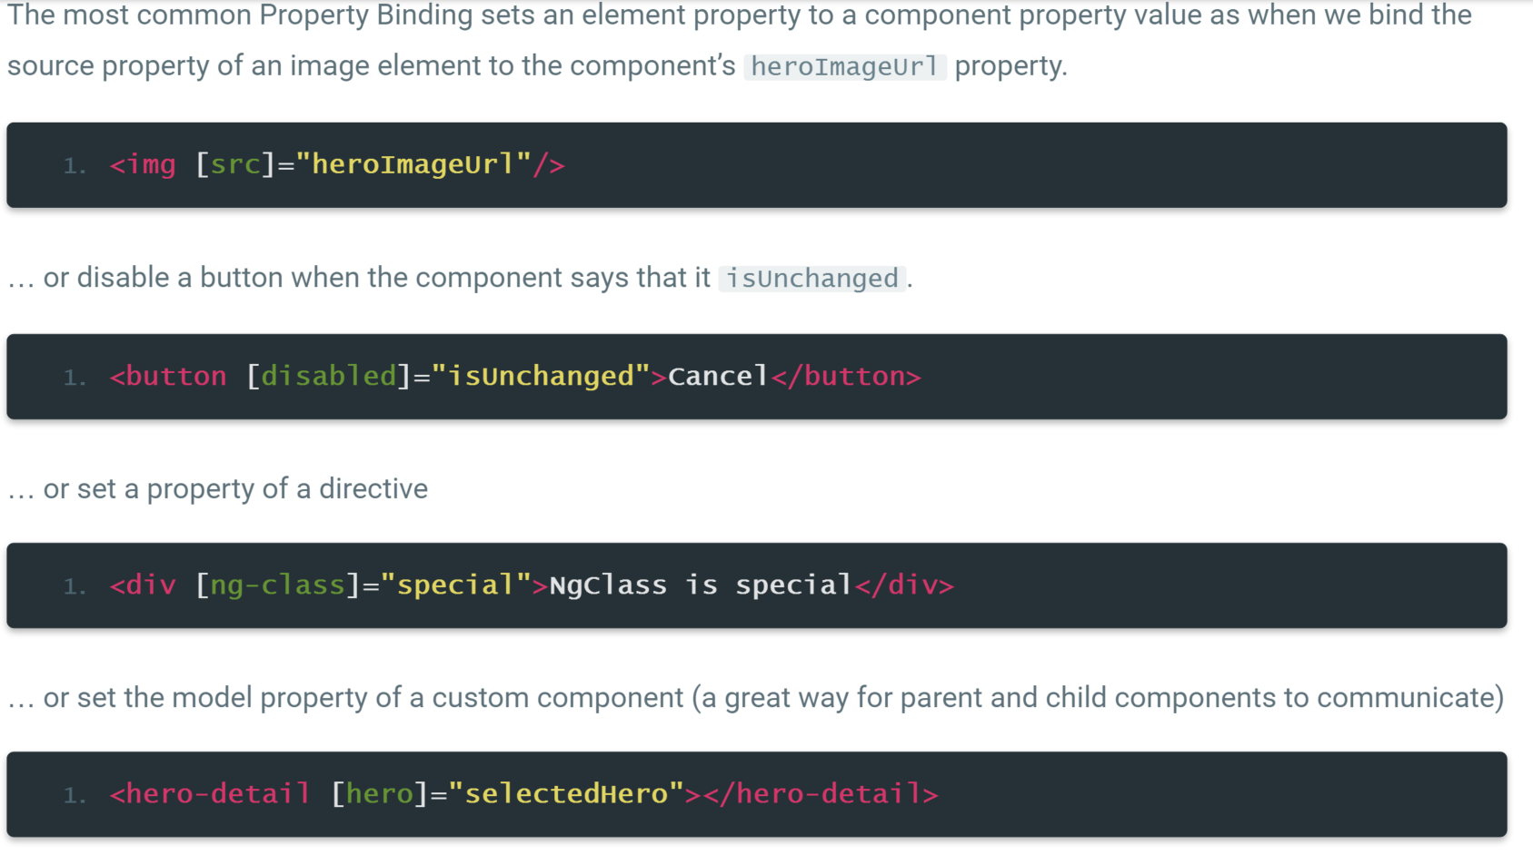
Property Binding

Slide 16
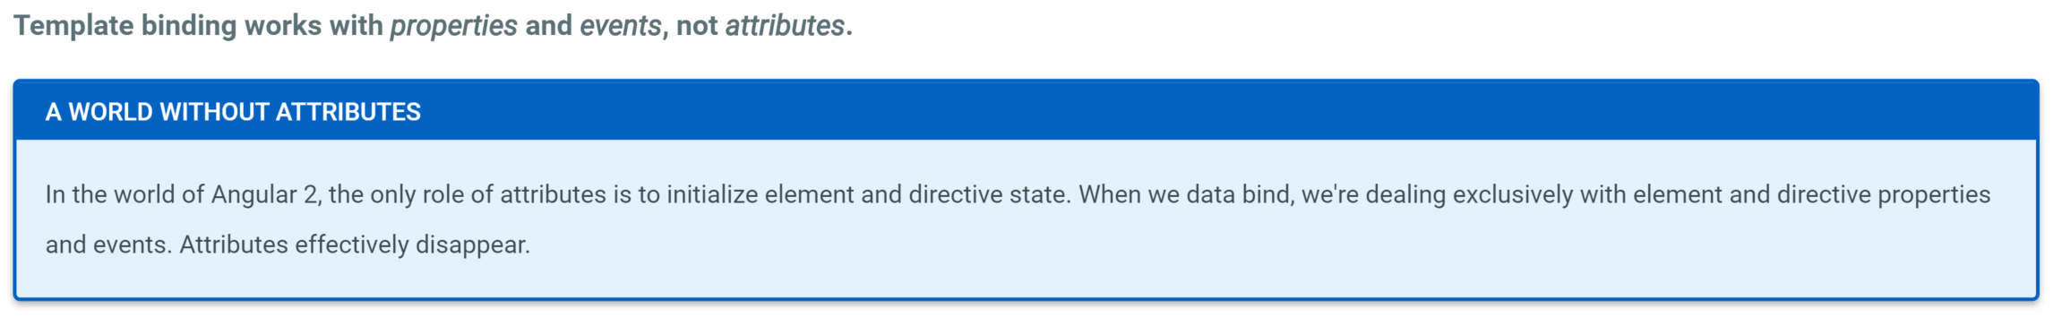
Property binding not attribute binding

Slide 17
Property Binding

Slide 18
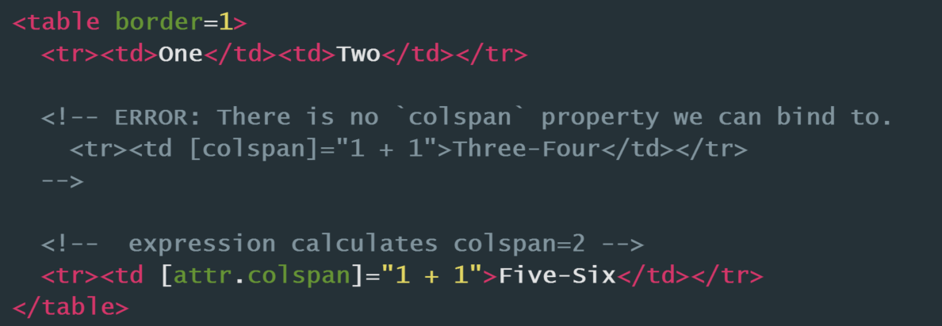
Attribute Bindings
Notes:
Some things are not available as properties only attributes so use the attribute tag
https://developer.mozilla.org/en-US/docs/Glossary/property
https://developer.mozilla.org/en-US/docs/Glossary/property

Slide 19
Class Bindings
Notes:
Some things are not available as properties only attributes so use the attribute tag
https://developer.mozilla.org/en-US/docs/Glossary/property
https://developer.mozilla.org/en-US/docs/Glossary/property

Slide 20
Style Bindings
Notes:
Some things are not available as properties only attributes so use the attribute tag
https://developer.mozilla.org/en-US/docs/Glossary/property
https://developer.mozilla.org/en-US/docs/Glossary/property

Slide 21
Event Binding
https://developer.mozilla.org/en-US/docs/Web/Events

Slide 22
Event Binding between elements

Slide 23
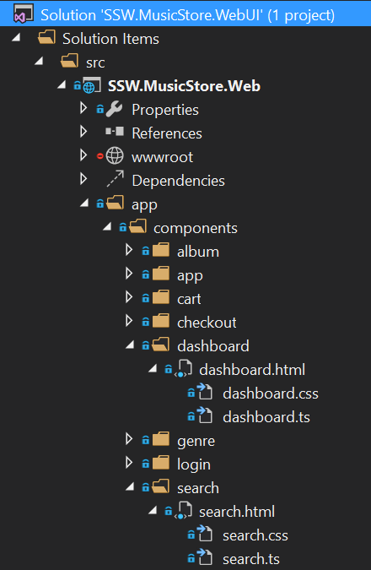
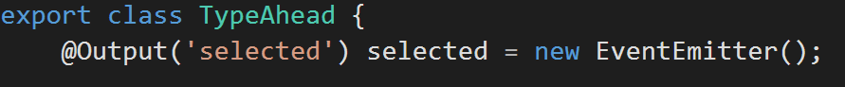

Slide 24
Two-Way Binding with ng-model

Slide 25
Built-in Directives

Slide 26
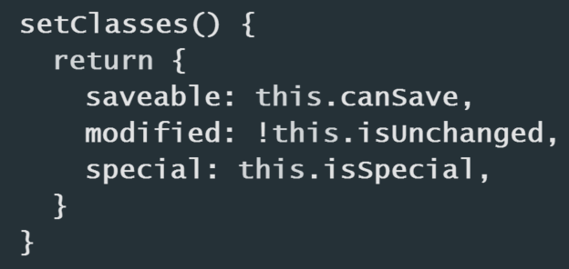
ng-class
Notes:
Some things are not available as properties only attributes so use the attribute tag
https://developer.mozilla.org/en-US/docs/Glossary/property
https://developer.mozilla.org/en-US/docs/Glossary/property

Slide 27
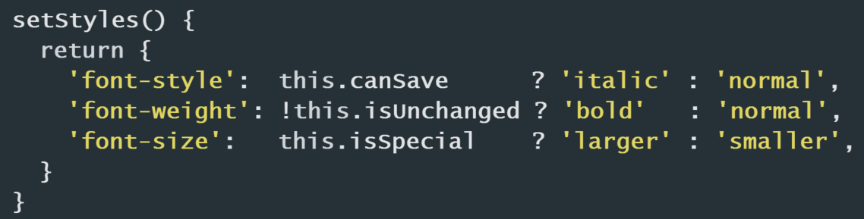
ng-style
Notes:
Some things are not available as properties only attributes so use the attribute tag
https://developer.mozilla.org/en-US/docs/Glossary/property
https://developer.mozilla.org/en-US/docs/Glossary/property

Slide 28
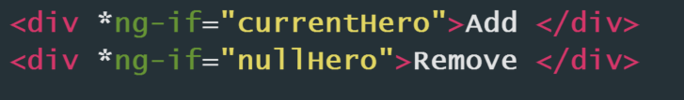
*ng-if
Notes:
Some things are not available as properties only attributes so use the attribute tag
https://developer.mozilla.org/en-US/docs/Glossary/property
https://developer.mozilla.org/en-US/docs/Glossary/property

Slide 29
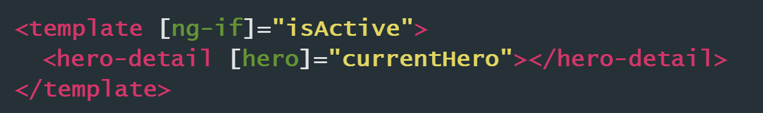
* Why the star?

Slide 30

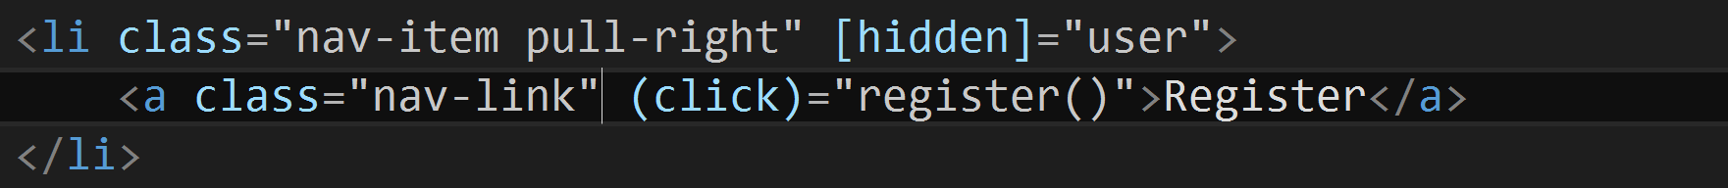
Visibility and *ng-If are not the same
Notes:
Some things are not available as properties only attributes so use the attribute tag
https://developer.mozilla.org/en-US/docs/Glossary/property
https://developer.mozilla.org/en-US/docs/Glossary/property

Slide 31
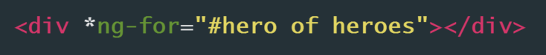
*ng-for
Notes:
Some things are not available as properties only attributes so use the attribute tag
https://developer.mozilla.org/en-US/docs/Glossary/property
https://developer.mozilla.org/en-US/docs/Glossary/property

Slide 32
Local template variables with #
We can reference a local template variable on the same element, on a sibling element, or on any of its children.

Slide 33
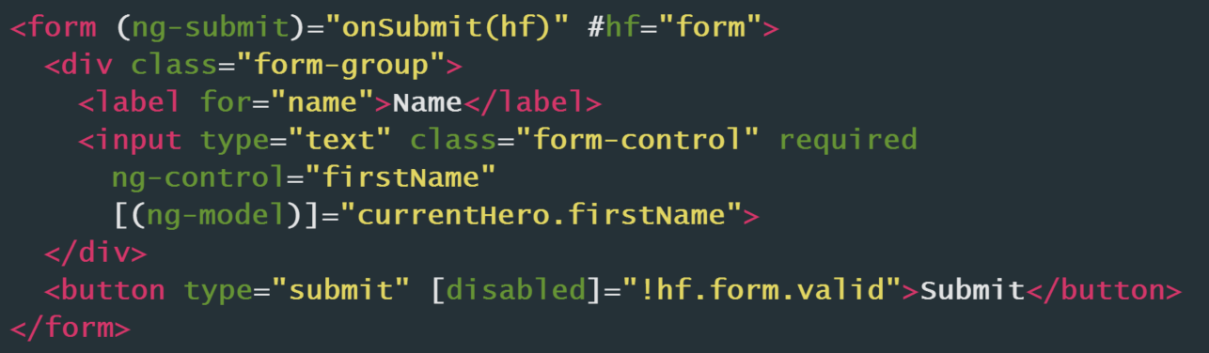
Local template variables with #

Slide 34
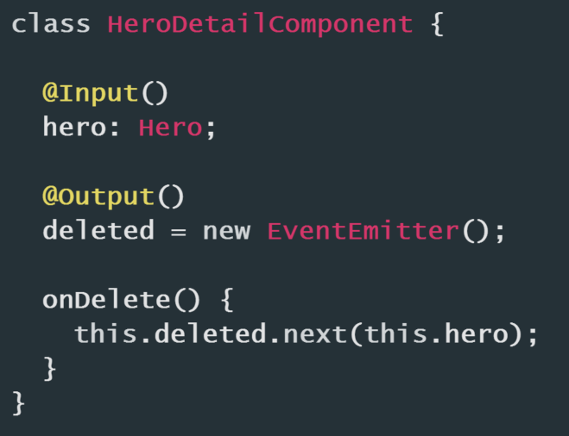
Input and Output Properties

Slide 36
The Pipe Operator ( | )

Slide 37
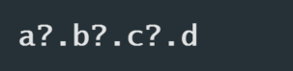
The Elvis Operator ( ?. ) and null property paths

Slide 38
Some template syntax tips

Slide 39
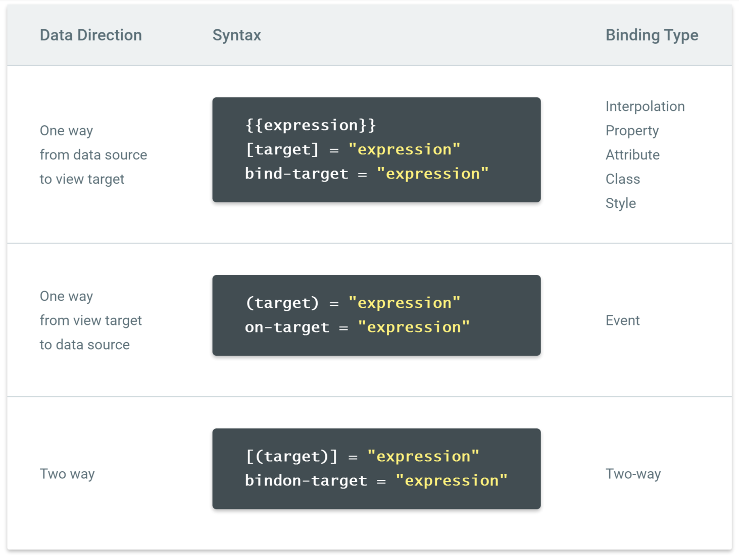

Slide 40
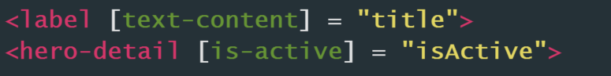
Use lower snake case

Slide 41
Some great Angular 2 template syntax resources

Slide 42
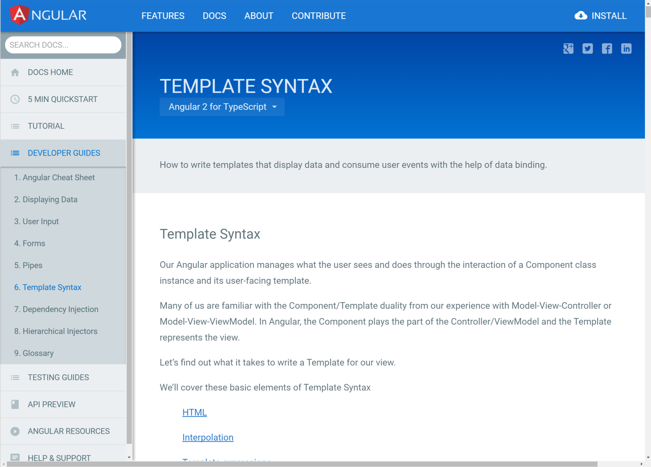

Slide 43
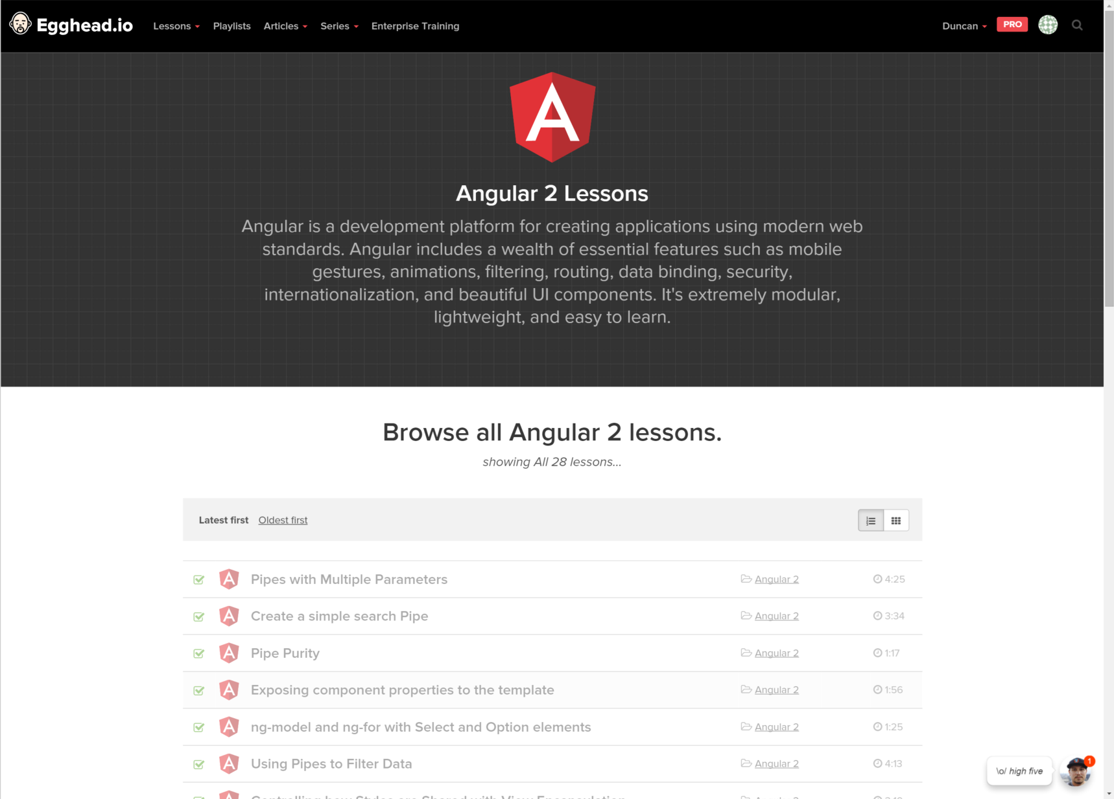

Slide 44
Summary
1. Why the new syntax?
2. Property Binding & Event Binding
3. Attribute, Class and Style Bindings
4. Built-in Directives
5. Input and Output Properties
Notes:
NOTE agenda same as finish
Approx. 45min for the 10 qu and the Q&A

Slide 45
Thank you! info@ssw.com.au www.ssw.com.au Sydney | Melbourne | Brisbane | Adelaide

